Slide 1

CSE101-Lec# 18,19
Pointers in C

Slide 2
Introduction-Pointer declaration and Initialization
A pointer is a variable that holds the address of another variable.
The general syntax of declaring pointer variable is
data_type *ptr_name;
Here, data_type is the data type of the value that the pointer will point to. For example:
int *pnum; char *pch; float *pfnum; //Pointer declaration
int x= 10;
int *ptr = &x; //Pointer initialization[ When some variable’s address is assigned to pointer, it is said to be initialized]
The '*' informs the compiler that ptr is a pointer variable and the int specifies that it will store the address of an integer variable. [ ‘*’ is also known as indirection/ or deferencing/ or value at address operator]
The & operator retrieves the address of x, and copies that to the contents of the pointer ptr. [ ‘&’ is also known as address of operator]

Slide 3
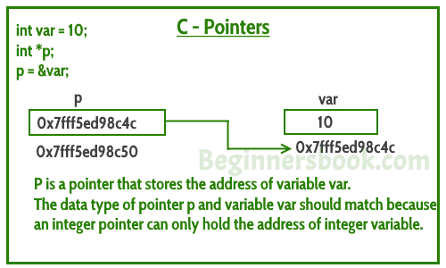
Understanding pointers

Slide 4
Pointer Operators
& (address operator)
Returns address of operand
int y = 5;
int *yPtr;
yPtr = &y; /* yPtr gets address of y */
yPtr “points to” y
y
yptr
y
yPtr
5
500000
600000
600000
5
Value of yptr is the address of y

Slide 5
Pointer Operators
* (indirection/dereferencing operator)
Returns the value of the variable that it points to.
*yptr returns value of y (because yptr points to y)
* can be used for assignment
*yptr = 7; /* changes y to 7 */

Slide 6
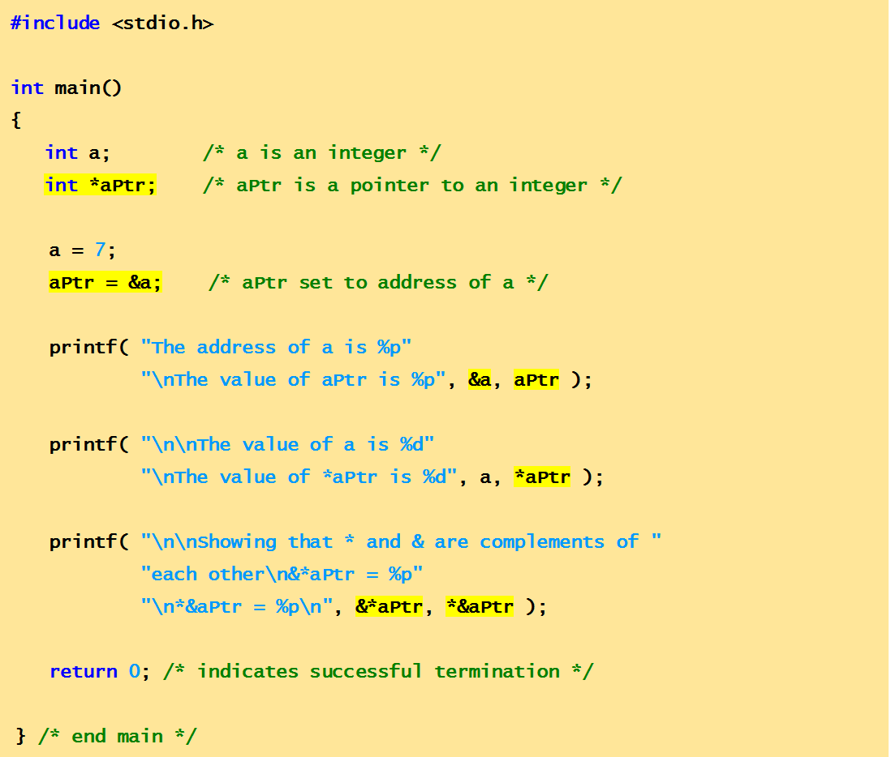
Example Code
This program demonstrates the use of the pointer operators: & and *

Slide 7
Output
The address of a is 0012FF7C
The value of aPtr is 0012FF7C
The value of a is 7
The value of *aPtr is 7
Showing that * and & are complements of each other.
&*aPtr = 0012FF7C
*&aPtr = 0012FF7C

Slide 8
Key points related to pointers
Data type of the pointer variable and variable whose address it will store must be of same type
Example:
int x=10;
float y=2.0;
int *px=&y;//Invalid, as px is of integer type and y is of float type
int *ptr=&x;//Valid as both ptr and x are of same types
Any number of pointers can point to the same address
Example:
int x=12;
int *p1=&x,*p2=&x,*p3=&x;// All the three pointers are pointing towards x
Memory taken by any kind of pointer(i.e int, float, char, double…) as always equivalent to the memory taken by unsigned integer, as pointer will always store address of a variable( which is always unsigned integer), so the type of pointer will not make any difference

Slide 9
Example-size taken by different type of pointers
#include<stdio.h>
int main()
{
int *pnum;
char *pch;
float *pfnum;
double *pdnum;
long *plnum;
printf("\n Size of integer pointer=%d",sizeof(pnum));
printf("\n Size of character pointer=%d",sizeof(pch));
printf("\n Size of float pointer=%d",sizeof(pfnum));
printf("\n Size of double pointer=%d",sizeof(pdnum));
printf("\n Size of long pointer=%d",sizeof(plnum));
return 0;
}
//All will give the same answer(equivalent to size taken by unsigned integer for a particular compiler)

Slide 10
Program example-Finding area of circle using pointers
#include<stdio.h>
int main()
{
double radius,area=0.0;
double *pradius=&radius,*parea=&area;
printf("\n Enter the radius of the circle:");
scanf("%lf",pradius);
*parea=3.14*(*pradius)*(*pradius);
printf("\n The area of the circle with radius %.2lf = %.2lf",*pradius,*parea);
return 0;
}

Slide 11
Program example-Factorial of a number using pointer
#include<stdio.h>
int main()
{
int i,n,fact=1;
int *pn,*pfact;
pn=&n;
pfact=&fact;
printf("\n Enter number:");
scanf("%d",pn);
for(i=1;i<=*pn;i++)
{
*pfact=*pfact*i;
}
printf("\n Factorial of number is:%d",*pfact);
return 0;
}

Slide 12
Program example-Reverse of a number using pointers
#include <stdio.h>
int main()
{
int n, reversedNumber = 0, remainder;
int *pn,*prn,*pr;
pn=&n;
prn=&reversedNumber;
pr=&remainder;
printf("Enter an integer: ");
scanf("%d", pn);
while(*pn != 0)
{
*pr = *pn%10;
*prn = *prn*10 + *pr;
*pn = *pn/10;
}
printf("Reversed Number = %d",*prn);
return 0;
}

Slide 13
Types of pointers
Null pointer
Wild pointer
Generic pointer(or void) pointer
Constant pointer
Dangling pointer

Slide 14
Null pointer
A Null Pointer is a pointer that does not point to any memory location
It is used to initialize a pointer variable when the pointer does not point to a valid memory address.
So, if we don’t know in the initial phases, where the pointer will point? , it is better to initialize pointer with NULL address
To declare a null pointer you may use the predefined constant NULL,
int *ptr = NULL;
or
int *ptr=0;
We can overwrite the NULL address hold by NULL pointer with some valid address also, in the later stages of program
Note: It is invalid to dereference a null pointer.

Slide 15
Example
#include<stdio.h>
int main()
{
int *ptr=NULL;
int a=10;
printf("%u",ptr);// 0 will be displayed
printf(“%d”,*ptr);//Invalid(Dereferencing), as ptr is NULL at this point.
ptr=&a;
printf("\n%d",*ptr);//Now it is allowed, as NULL pointer has starting pointing somewhere
return 0;
}

Slide 16
Wild pointer
Pointer which are not initialized during its definition holding some junk value( or Garbage address) are Wild pointer.
Example of wild pointer:
int *ptr;
Every pointer when it is not initialized is defined as a wild pointer.
As pointer get initialized, start pointing to some variable its defined as pointer, not a wild one.

Slide 17
Example
#include<stdio.h>
int main()
{
int *ptr;//Wild pointer
int a=10;
//printf("%u",ptr);//Gives garbage address value
//printf("\n%d",*ptr);//Gives garbage value stored in the garbage address
ptr=&a;//Now ptr is not a wild pointer
printf("\n%d",*ptr);//
return 0;
}

Slide 18
Void pointer
Is a pointer that can hold the address of variables of different data types at different times also called generic pointer.
The syntax for declaring a void pointer is
void *pointer_name;
Here, the keyword void represents that the pointer can point to value of any data type.
But before accessing the value through generic pointer by dereferencing it, it must be properly typecasted.
To Print value stored in pointer variable:
*(data_type*) pointer_name;

Slide 19
Limitations of void pointers:
void pointers cannot be directly dereferenced. They need to be appropriately typecasted.
Pointer arithmetic cannot be performed on void pointers.

Slide 20
Example
#include<stdio.h>
int main()
{
int x=10;
char ch='A';
void *gp;
gp=&x;
printf("\n Generic pointer points to the integer value=%d",*(int*)gp);
gp=&ch;
printf("\n Generic pointer now points to the character %c",*(char*)gp);
return 0;
}

Slide 21
Constant Pointers
A constant pointer, ptr, is a pointer that is initialized with an address, and cannot point to anything else.
But we can use ptr to change the contents of variable pointing to
Example int value = 22; int * const ptr = &value;

Slide 22
Constant Pointer
Example: int * const ptr2
indicates that ptr2 is a pointer which is constant. This means that ptr2 cannot be made to point to another integer.
However the integer pointed by ptr2 can be changed.

Slide 23
Example
#include<stdio.h>
int main()
{
int var1 = 60, var2 = 70;
int *const ptr = &var1;
printf("\n%d",*ptr);
//ptr = &var2; //Invalid-Error will arise
//printf("%d\n", *ptr);
return 0;
}

Slide 24
Dangling pointer
It is a type of pointer which point towards such a memory location which is already deleted/ or deallocated.
It is a problem associated with pointers, where in a pointer is unnecessarily pointing towards deleted memory location
It can be resolved through assigning NULL address once, the memory has been deallocated

Slide 25
Dangling pointer-Example 1[Compile time case] When local variable goes out of scope
#include<stdio.h>
int main()
{
int *ptr;
{
int val=23;
ptr=&val;
printf("\n%d",*ptr);// 23 is printed
printf("\n%u",ptr);// Address of val is printed
}
printf("\n%u",ptr);// Same address is printed, even val is destroyed, hence ptr is dangling pointer
ptr=NULL;//Solution
printf("\n%u",ptr);// Now ptr is not a dangling pointer[0 address value is printed]
return 0;
}

Slide 26
Dangling pointer-Example 2[Runtime/or Dynamic memory allocation case] When free() function is called
// Deallocating a memory pointed by ptr causes
// dangling pointer
#include <stdlib.h>
#include <stdio.h>
int main()
{
int n=1;
int *ptr = (int *)malloc(n*sizeof(int));
*ptr=6;
printf("%d",*ptr);//6 is printed
printf("\n%d",ptr);//Printing address hold by pointer before deallocation
free(ptr);
printf("\n%d",ptr);//Same address will be printed(Dangling pointer)
//SOLUTION
ptr = NULL;//Pointer is now changed to NULL pointer
printf("\n%d",ptr);//0 will be printed
return 0;
}

Slide 27
Example-1-Passing pointer to a function(or call by reference)
//Passing arguments to function using pointers
#include<stdio.h>
void sum(int *a,int *b,int *t);
int main()
{
int num1,num2,total;
printf("\n Enter the first number:");
scanf("%d",&num1);
printf("\n Enter the second number:");
scanf("%d",&num2);
sum(&num1,&num2,&total);
printf("\n Total=%d",total);
return 0;
}
void sum(int *a,int *b,int *t)
{
*t=*a+*b;
}

Slide 28
Example-2-Passing pointer to a function(or call by reference)
#include<stdio.h>
void read(float *b,float *h);
void calculate_area(float *b,float *h,float *a);
int main()
{
float base,height,area;
read(&base,&height);
calculate_area(&base,&height,&area);
printf("\n Area is :%f",area);
return 0;
}
void read(float *b,float *h)
{
printf("\n Enter the base of the triangle:");
scanf("%f",b);
printf("\n Enter the height of the triangle:");
scanf("%f",h);
}
void calculate_area(float *b,float *h,float *a)
{
*a=0.5*(*b)*(*h);
}

Slide 29
Q1
What will be the output of the following C code?
#include <stdio.h>
int main()
{
int *ptr, a = 10;
ptr = &a;
*ptr += 1;
printf("%d,%d", *ptr, a);
}
A. 10,10
B. 10,11
C. 11,10
D. 11,11
Notes:
11,11

Slide 30
Q2
Comment on the following pointer declaration.
int *ptr, p;
A. ptr is a pointer to integer, p is not
B. ptr and p, both are pointers to integer
C. ptr is a pointer to integer, p may or may not be
D. ptr and p both are not pointers to integer
Notes:
A

Slide 31
Q3
What will be the output of the following C code?
#include <stdio.h>
int x = 0;
int main()
{
int *ptr = &x;
printf("%p\n", ptr);
x++;
printf("%p\n ", ptr);
}
A. Same address
B. Different address
C. Compile time error
D. None of these
Notes:
A

Slide 32
Q4
#include <stdio.h>
int main()
{
int x=10;
int *p1=&x,*p2;
*p1=x+3;
p2=p1;
*p2=*p1+2;
printf("%d",x);
return 0;
}
A. 13
B. 12
C. 10
D. 15
Notes:
D

Slide 33
Q5
What will be the output of the following C code?
#include <stdio.h>
int main()
{
char *p = NULL;
char *q = 0;
if (p)
printf(" p ");
else
printf("nullp");
if (q)
printf("q\n");
else
printf(" nullq\n");
}
a) nullp nullq
b) Nothing will be printed
c) Compile time error
d) p q
Notes:
a

Slide 34
Q6
What will be the output of the following C code?
#include <stdio.h>
int main()
{
int i = 10;
void *p = &i;
printf("%d\n", (int)*p);
return 0;
}
A. Compile time error
B. Program will crash
C. 10
D. Address of i
Notes:
(A) it should be *(int*)p

Slide 35
Q7
What will be the output of the following C code?
#include <stdio.h>
int main()
{
int i = 10;
void *p = &i;
printf("%f\n", *(float*)p);
return 0;
}
A. Compile time error
B. 10.000000
C. 10
D. 0.000000
Notes:
D) Because ``i`` is int first

Slide 36
Q8
What will be the output of the following C code?
#include <stdio.h>
int x = 0;
void main()
{
int *const ptr = &x;
printf("%p\n", ptr);
ptr++;
printf("%p\n ", ptr);
}
A. 0 1
B. Compile time error
C. 0xbfd605e8 0xbfd605ec
D. 0xbfd605e8 0xbfd605e8
Notes:
B

Slide 37
Q9
What will be the output of the following C code?
#include <stdio.h>
void foo(int *p)
{
int j = 2;
p = &j;
printf("%d ", *p);
}
int main()
{
int i = 97, *p = &i;
foo(&i);
printf("%d ", *p);
}
A. 2 97
B. 2 2
C. Compile time error
D. Program will crash
Notes:
2 97

Slide 38
Q10
What will be the output of the following C code?
#include <stdio.h>
void m(int *p, int *q)
{
p=q;
*p=8;
*q=7;
}
int main()
{
int a = 6, b = 5;
m(&a, &b);
printf("%d %d\n", a, b);
}
a) 8 7
b) 6 7
c) 6 5
d) 8 8
Notes:
6 7

